Slide 1
Laptop Reviews
Your best decision is our will

Slide 2
Team member
Supervisor: Mr. Kiều Trọng Khánh
Võ Thị Minh Châu
Nguyễn Văn Hơn (Dropped out)
Đinh Hữu Toàn
Nguyễn Mạnh Khương

Slide 3
Outline
Scenario problem
Our solution
Demonstration
Advantages and disadvantages of current solution
Questions and answers
Future Plans

Slide 4




Scenario problem
Notes:
- ngta can biet thong tin de lam gi do, de tra cuu, de so sanh de tim hieu, mua...

Slide 5
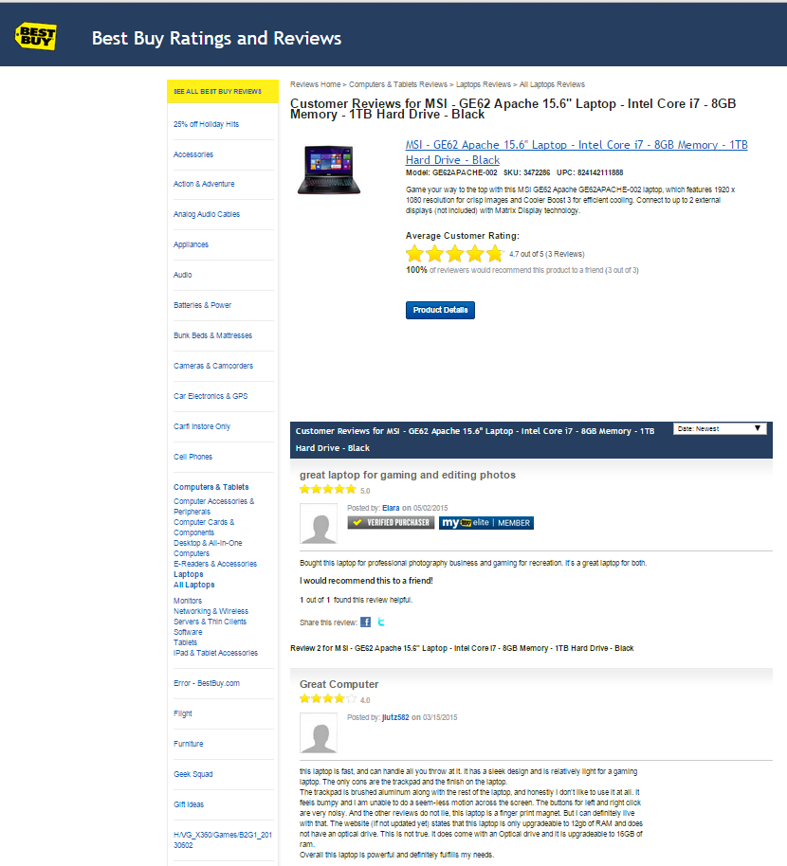
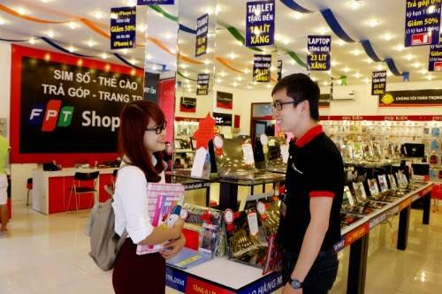
Scenario problem
Notes:
Search online các website
Nếu có thời gian thì đi ra các cửa hàng để tham quan và lấy thông tin từ đó

Slide 6
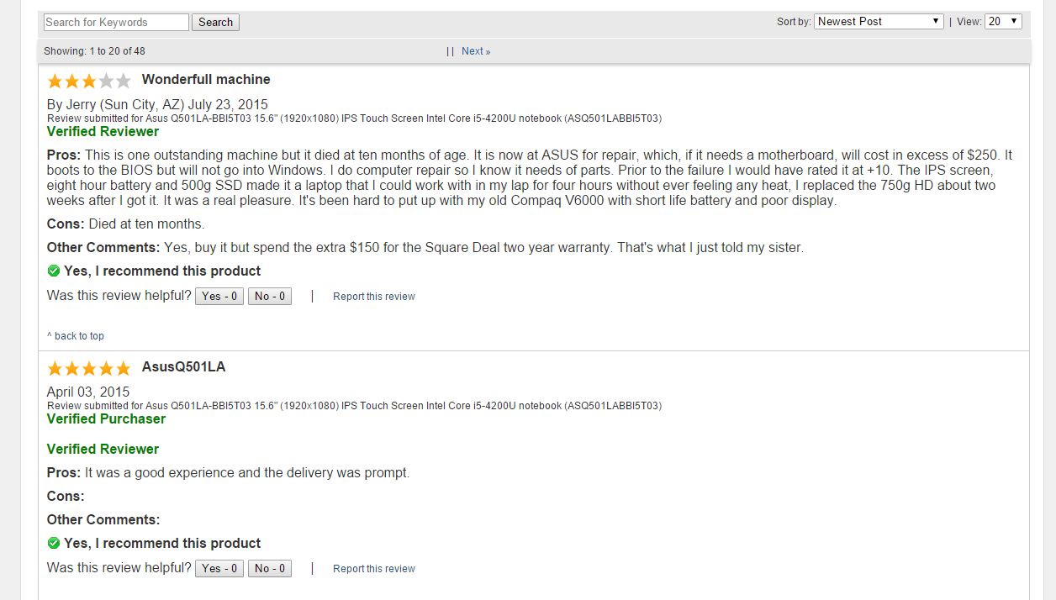
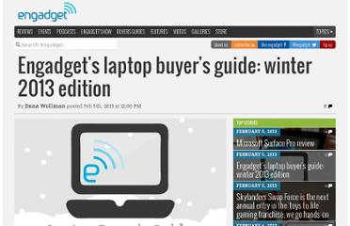
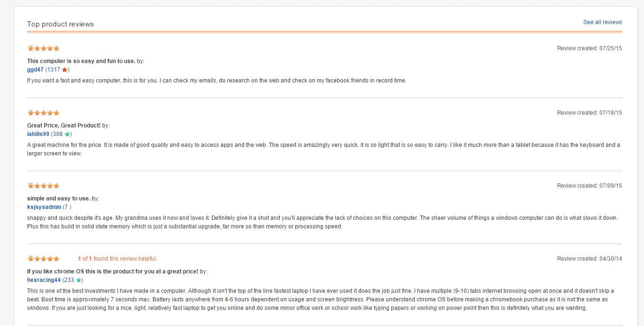
Scenario problem
Take lots of time to search for trusted websites and read all the reviews
1
Notes:
Các website không đáng tin cậy
Thông tin không chính thống, mông lung

Slide 7
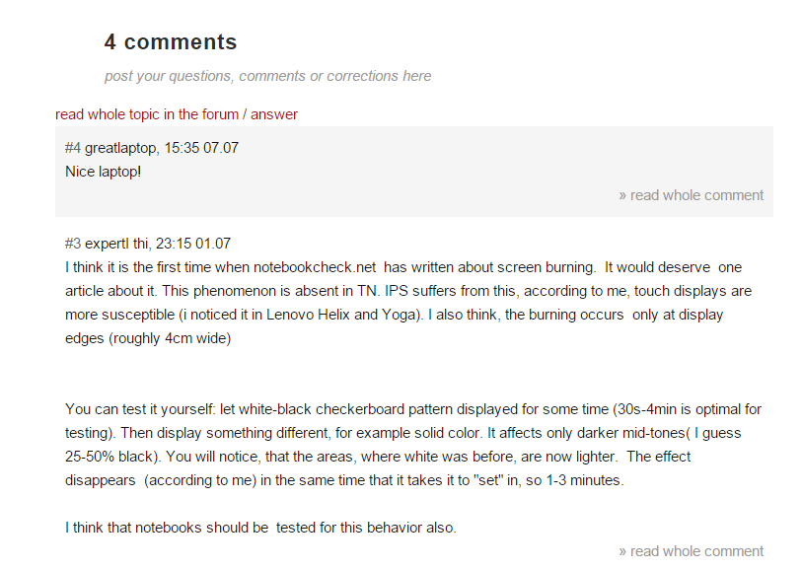

Scenario problem
2
Some reviews may be useless or not relevant.
Notes:
Các bình luận không liên quan
Bình luận không chuẩn, quá ngắn, quá dài và nhiều khi chỉ là một lời cảm thán mang nặng tính cá nhân

Slide 8

Scenario problem
Hard to remember exactly the information these supermarkets provide
3
Notes:
1. Nếu đi ra cửa hàng thì khó nhớ thông tin

Slide 9

Scenario problem
1
2
3
What is the best way to have good reviews?
Notes:
Tìm kiếm thông tin từ những trang web uy tín
Tiến hành làm sạch và chuẩn hóa các bình luận, để người dùng có thể tìm được thông tin nhanh chóng và chính xác

Slide 10
Our Solution

Slide 11


Our solution
Find trusted websites

Slide 12



Our solution
Find trusted websites
Collect information

Slide 13


Our solution
Find trusted websites
Collect information
Standardize comments
Notes:
=> giới thiệu C trình bày cách lấy dữ liệu

Slide 14
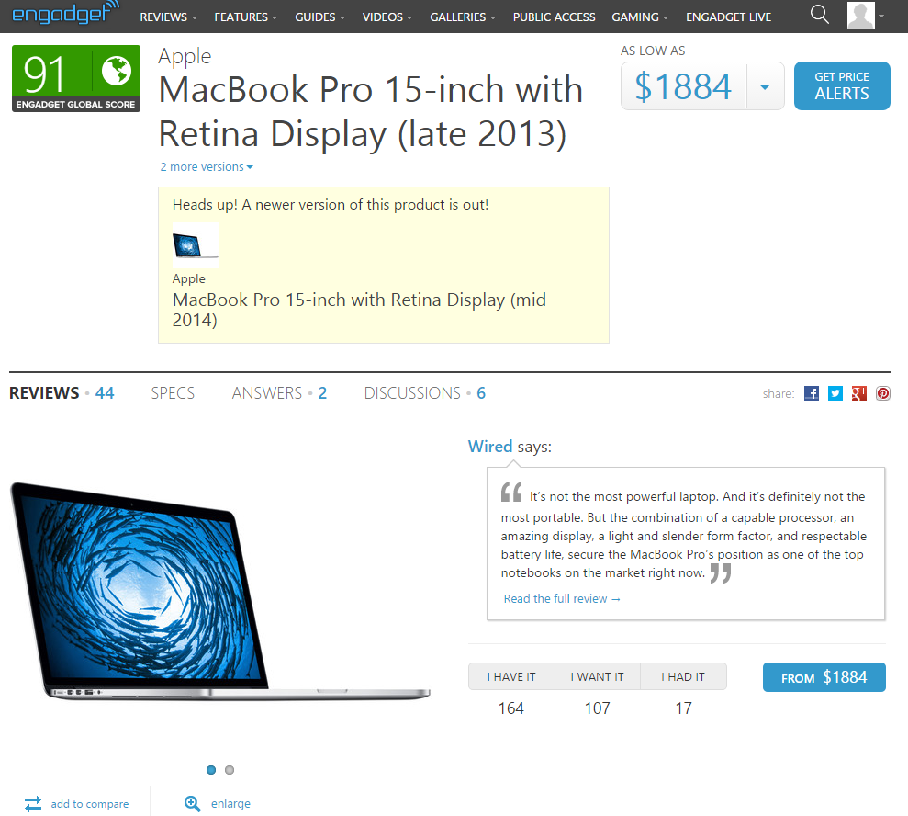
Our solution Step 1: Find trusted website
http://www.engadget.com/
Notes:
1. de lay thong tin laptop, chung toi phai tim trang web va dua thong tin do ve
chung toi tim dc trang web engadget, day la 1 trang web co thong tin ve laptop kha chuan.

Slide 15




Our solution Step 1: Find trusted website
Comments are approved before publishing.
Notes:
chung toi quyet dinh dung trang web tieng anh boi vi du sao tieng anh cung tot hon tieng viet
ngoai engadget con lay them 2 trang nua, vi nhung trang nay khi cmt thi phai cho staff duyet

Slide 16

Collect data by parsing
How to get data from this site?
Notes:
va cau hoi dat ra la lam sao de lay dc thong tin tu trang web nay ve

Slide 17
Collect data by parsing
Notes:
va cau hoi dat ra la lam sao de lay dc thong tin tu trang web nay ve

Slide 18
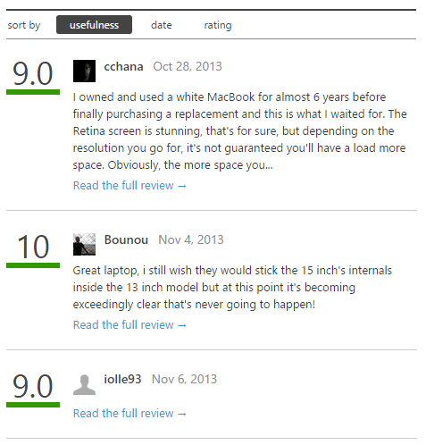
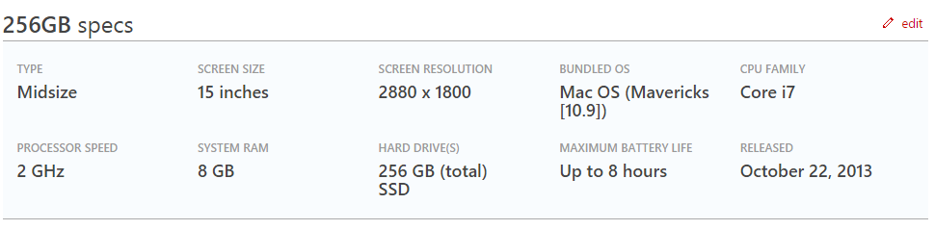
Collect data by parsing

Slide 19
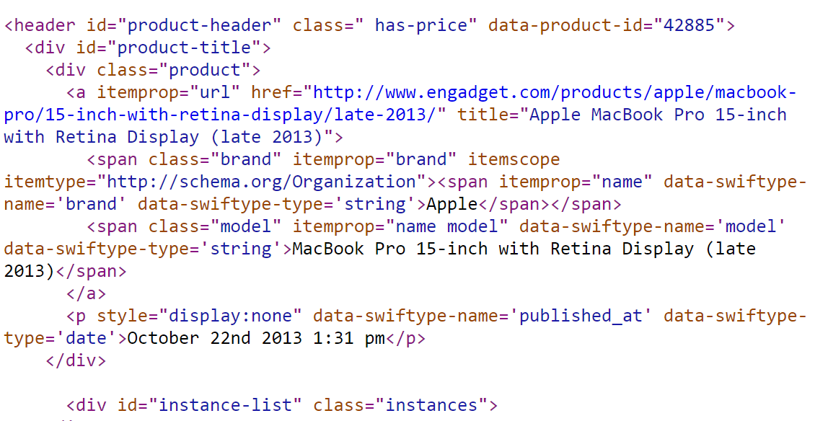
Collect data by parsing
Notes:
show trang engadget len, cho thay trang nay co nhung thong tin: ten, brand, desc, cmt...
chup hinh trang engadget dang html. de parse dc trang html nay thi co solution gi, gap van de gi
Phan tich ra, phong ra tu trang 17. VD ra

Slide 20
Collect data by parsing
Notes:
show trang engadget len, cho thay trang nay co nhung thong tin: ten, brand, desc, cmt...
chup hinh trang engadget dang html. de parse dc trang html nay thi co solution gi, gap van de gi
Phan tich ra, phong ra tu trang 17. VD ra

Slide 21
Collect data by parsing
<span class="model" itemprop="name model" data-swiftype-name='model' data-swiftype-type='string'>MacBook Pro 15-inch with Retina Display (late 2013)</span>
Notes:
show trang engadget len, cho thay trang nay co nhung thong tin: ten, brand, desc, cmt...
chup hinh trang engadget dang html. de parse dc trang html nay thi co solution gi, gap van de gi
Phan tich ra, phong ra tu trang 17. VD ra

Slide 22
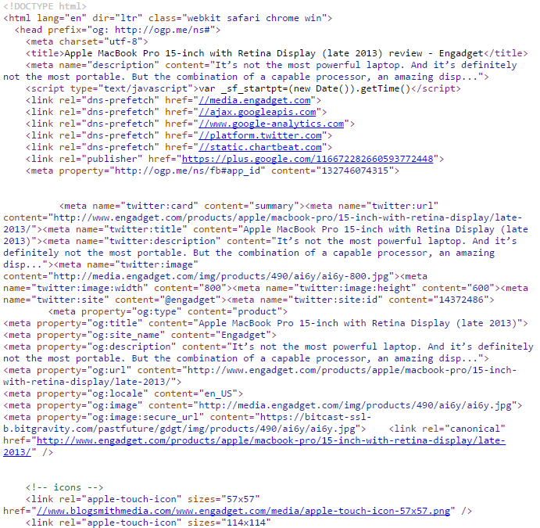
Collect data by parsing
xPath
Notes:
show trang engadget len, cho thay trang nay co nhung thong tin: ten, brand, desc, cmt...
chup hinh trang engadget dang html. de parse dc trang html nay thi co solution gi, gap van de gi

Slide 23
Collect data by parsing
Libraries support parsing data:
Selenium
vs
HtmlAgilityPack

Slide 24

Collect data by parsing
Libraries support parsing data:
Selenium
vs
HtmlAgilityPack
Create
simulator browser

Slide 25

Collect data by parsing
Libraries support parsing data:
Selenium
vs
HtmlAgilityPack
Create
simulator browser
Parse data

Slide 26
Collect data by parsing
Libraries support parsing data:
Selenium
vs
HtmlAgilityPack
Create
simulator browser
Parse data
Parse data

Slide 27

Collect data by parsing
Libraries support parsing data:
Selenium
vs
HtmlAgilityPack
Create
simulator browser
Parse data
Decrease speed
Parse data

Slide 28
Collect data by parsing
Libraries support parsing data:
Selenium
vs
HtmlAgilityPack
Create
simulator browser
Parse data
Decrease speed
Parse data

Slide 29

Collect data by parsing

Slide 30

Collect data by parsing
Take url
Remove script

Slide 31

Collect data by parsing
Take url
Download
Remove script

Slide 32

Collect data by parsing
Take url
Download
Remove script
Display

Slide 33
Collect data by parsing
Take url
Download
Remove script
Display
xPath
Get
Notes:
Inspect ? => s

Slide 34
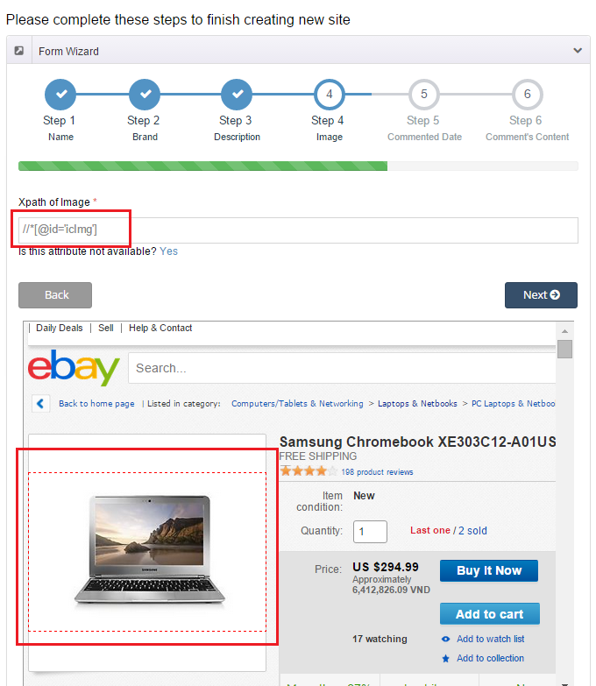
How to get data?

Slide 35
Collect data by parsing
Step 1: From clicked node

Slide 36
Collect data by parsing
Step 1: From clicked node
Step 2: Get parent node

Slide 37
Collect data by parsing
Step 1: From clicked node
Step 2: Get parent node
Step 3: Stop when meeting “HTML” or “ID” node

Slide 38
Collect data by parsing
Step 1: From clicked node
Step 2: Get parent node
Step 3: Stop when meeting “HTML” or “ID” node
Step 4: Take xPath

Slide 39
Collect data by parsing
Step 1: From clicked node
Step 2: Get parent node
Step 3: Stop when meeting “HTML” or “ID” node
Step 4: Take xPath
Step 5: Get data

Slide 40
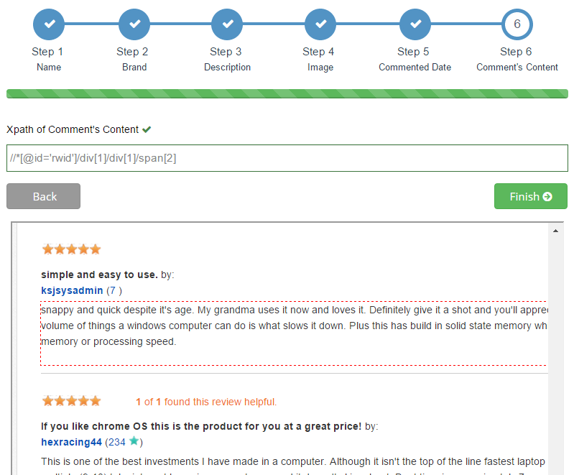
Step 1, 2 & 3: Get parent node, stop when meeting “html” or “id” node

Slide 41
Step 1, 2 & 3: Get parent node, stop when meeting “html” or “id” node
Clicked node
span[2]

Slide 42
Step 1, 2 & 3: Get parent node, stop when meeting “html” or “id” node
Parent node
Clicked node
div[1] /
span[2]

Slide 43
Step 1, 2 & 3: Get parent node, stop when meeting “html” or “id” node
Parent node
Clicked node
div[1] /
div[1] /
span[2]

Slide 44
Step 1, 2 & 3: Get parent node, stop when meeting “html” or “id” node
“id” node
Parent node
Clicked node
*[@id='rwid']/
div[1] /
div[1] /
span[2]

Slide 45
Step 1, 2 & 3: Get parent node, stop when meeting “html” or “id” node
“id” node
Parent node
Clicked node
//
*[@id='rwid']/
div[1] /
div[1] /
span[2]

Slide 46
Step 1, 2 & 3: Get parent node, stop when meeting “html” or “id” node
“id” node
Parent node
Clicked node
//
*[@id='rwid']/
div[1] /
div[1] /
span[2]
//*[@id='rwid']/div[1]/div[1]/span[2]

Slide 47
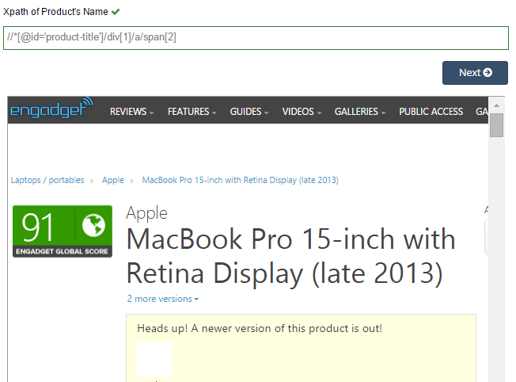
Step 4&5: Take xPath and Get data

Slide 48
Step 4&5: Take xPath and Get data

Slide 49
Step 4&5: Take xPath and Get data
MacBook Pro 15-inch with Retina Display (late 2013)

Slide 50
Step 4&5: Take xPath and Get data
MacBook Pro 15-inch with Retina Display (late 2013)
Product
Name

Slide 51
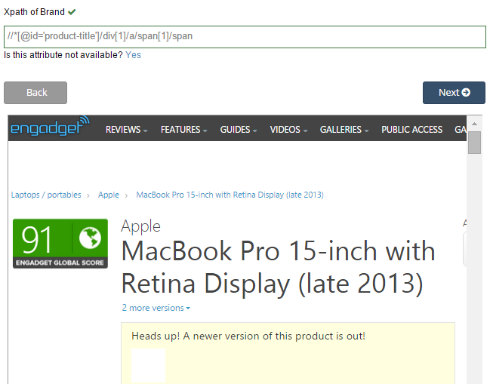
Step 4&5: Take xPath and Get data
Apple
Product
Name
Brand

Slide 52
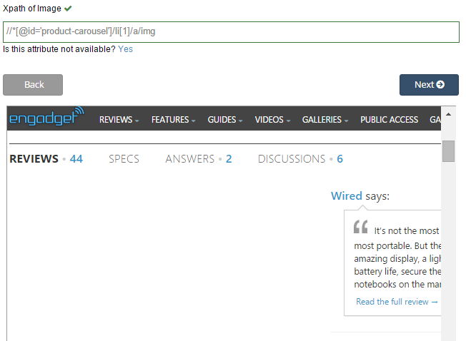


Step 4&5: Take xPath and Get data
Product
Name
Brand
Image

Slide 53
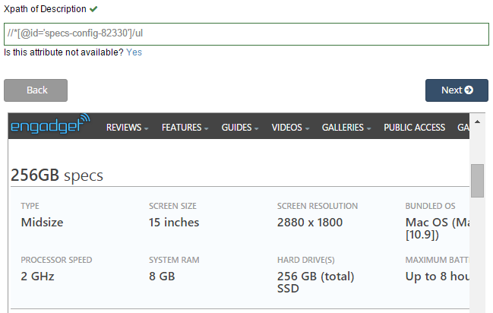
Step 4&5: Take xPath and Get data
Type: Midsize
Screen size: 15 inches
…
Product
Name
Brand
Image
Description

Slide 54
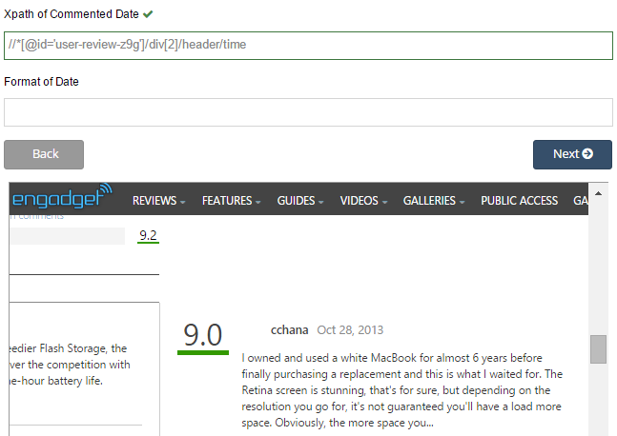
Step 4&5: Take xPath and Get data
Oct 28, 2013
Product
Name
Brand
Image
Description
Comment’s date

Slide 55
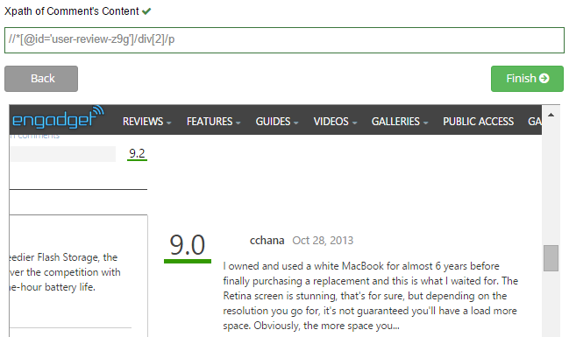
Step 4&5: Take xPath and Get data
I owned and used a white MacBook for almost 6 years before finally purchasing a replacement…
Product
Name
Brand
Image
Description
Comment’s date
Comment’s content

Slide 56
Collect data by parsing
We have these entities
Product
Url
Name
Brand
Description
Image
Comment’s date
Comment’s content

Slide 57
Collect data by parsing
We have these entities
Product
Url
Name
Brand
Description
Image
Last comment’s date
Comment’s content

Slide 58
Collect data by parsing
We have these entities
Product
Site
Url
Name
Brand
Description
Image
Last comment’s date
Comment’s content
Domain
Name’s xpath
Brand’s xpath
Description’s xpath
Image’s xpath
Date’s xpath
Content’s xpath

Slide 59
Collect data by parsing
We have these entities
Product
Site
Url
Name
Brand
Description
Image
Last comment’s date
Comment’s content
Domain
Name’s xpath
Brand’s xpath
Description’s xpath
Image’s xpath
Date’s xpath
Content’s xpath
0..*
1..*
2 different websites have a laptop with different information.
Notes:
trong qua trinh collection du lieu, chung toi da nhan thay dc 1 dieu: 2 trang web khac nhau voi cung 1 laptop co thong tin khac nhau. vi vay chung toi moi nghi ra cach
problem

Slide 60
Collect data by parsing
We have these entities
Product
Site
Brand
Description
Image
Domain
Name’s xpath
Brand’s xpath
Description’s xpath
Image’s xpath
Date’s xpath
Content’s xpath
0..*
1..*
Alias Product
Url
Name
Last comment’s date
Content’s xpath

Slide 61
Detect Duplicated Product String Comparision

Slide 62
Detect Duplicated Product String Comparision
Step 1: Split into a list of character pairs

Slide 63
Detect Duplicated Product String Comparision
Step 1: Split into a list of character pairs
Step 2: Count how many adjacent character pairs

Slide 64
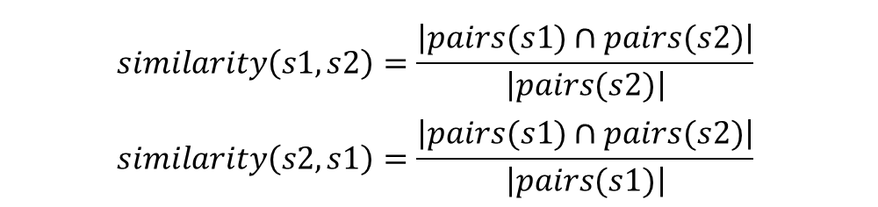
Detect Duplicated Product String Comparision
Step 1: Split into a list of character pairs
Step 2: Count how many adjacent character pairs
Step 3: Calculate matching percent
$$similarity\left(s1,s2\right)=\frac{\left|pairs(s1)∩pairs(s2)\right|}{\left|pairs(s2)\right|}$$
$$similarity\left(s2,s1\right)=\frac{\left|pairs(s1)∩pairs(s2)\right|}{\left|pairs(s1)\right|}$$

Slide 65
Detect Duplicated Product String Comparision
s1
s2
MacBook Air 2015
MacBook Air 2015 Retina

Slide 66
Detect Duplicated Product String Comparision
s1
s2
MacBook Air 2015
MacBook Air 2015 Retina
MACBOOK AIR 2015
MACBOOK AIR 2015 RETINA

Slide 67
Detect Duplicated Product String Comparision
s1
s2
MacBook Air 2015
MacBook Air 2015 Retina
MACBOOK AIR 2015
MACBOOK AIR 2015 RETINA
$$\left\{MA,AC,CB,BO,OO,OK,AI,IR,20,01,15\right\}$$
$$\left\{MA,AC,CB,BO,OO,OK,AI,IR,20,01,15,RE,ET,TI,IN,NA\right\}$$

Slide 68
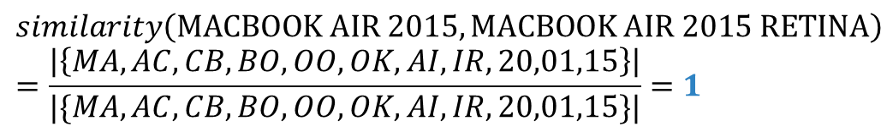
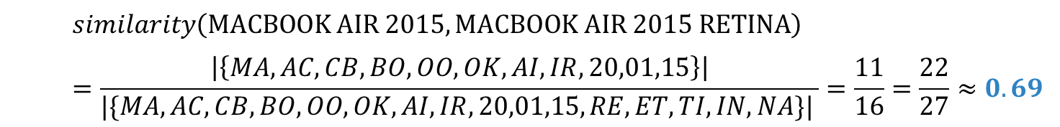
Detect Duplicated Product String Comparision
s1
s2
MacBook Air 2015
MacBook Air 2015 Retina
MACBOOK AIR 2015
MACBOOK AIR 2015 RETINA
$$\left\{MA,AC,CB,BO,OO,OK,AI,IR,20,01,15\right\}$$
$$\left\{MA,AC,CB,BO,OO,OK,AI,IR,20,01,15,RE,ET,TI,IN,NA\right\}$$
$$similarity\left(MACBOOK AIR 2015,MACBOOK AIR 2015 RETINA\right)=\frac{\left|\left\{MA,AC,CB,BO,OO,OK,AI,IR,20,01,15\right\}\right|}{|\{MA,AC,CB,BO,OO,OK,AI,IR,20,01,15,RE,ET,TI,IN,NA\}| }=\frac{11}{16}=\frac{22}{27}≈0.69$$
$$similarity\left(MACBOOK AIR 2015,MACBOOK AIR 2015 RETINA\right)=\frac{\left|\left\{MA,AC,CB,BO,OO,OK,AI,IR,20,01,15\right\}\right|}{|\{MA,AC,CB,BO,OO,OK,AI,IR,20,01,15\}|}=1$$
Notes:
Them ct min

Slide 69
Detect Duplicated Product String Comparision
$$min⁡(similarity\left(s1, s2), similarity(s2, s1)\right)=\min\left(0.69, 1\right)=0.69$$
similarity = 69 %

Slide 70

Detect Duplicated Product
New laptop

Slide 71

Detect Duplicated Product
New laptop
Data object
Database

Slide 72
Detect Duplicated Product
New laptop
Data object
Database

Slide 73
Detect Duplicated Product
New laptop
Data object
Database
is new
different brand
+
similarity < 40%
Notes:
Cùng brand và > 40%

Slide 74

Detect Duplicated Product
New laptop
Data object
Database
is new
different brand
+
similarity < 40%
true
Notes:
dk

Slide 75
Detect Duplicated Product
New laptop
Data object
Database
is new
false
different brand
+
similarity < 40%
true

Slide 76

Detect Duplicated Product
New laptop
Data object
Database
is new
false
different brand
+
similarity < 40%
true
save
Notes:
Giới thiệu T trình bày cách xử lý sp trùng

Slide 77







Handle Duplicated Product
Main
Alias
Database
Description
Description
Save
Comments
Comments
Images
Images
Merge
Main

Slide 78


Handle Duplicated Product
MacBook Pro 12' 2015

Slide 79



Handle Duplicated Product
Database
MacBook Pro 12' 2015
MacBook (early 2015)

Slide 80
Handle Duplicated Product
Database
MacBook Pro 12' 2015
MacBook (early 2015)

Slide 81
Handle Duplicated Product
Database
MacBook Pro 12' 2015
MacBook (early 2015)

Slide 82
Handle Duplicated Product
Database
MacBook Pro 12' 2015
MacBook (early 2015)

Slide 83

Handle Duplicated Product
Alias 1
Alias 2
Database
Description
Description
Save
Save
Comments
Comments
Images
Images
Split
New Laptop
New Laptop

Slide 84


Analyzing Comment
In real life
How can system classify the comments?
Can we train it?

Slide 85

Analyzing Comment
Notes:
Ask English teacher

Slide 86

Analyzing Comment
WORDS
4.Other
1.Adjective/
Adverb
3.Noun
2.Verb
Meaning
Pros
Neutral
Cons
Negative

Slide 87


Analyzing Comment – Get words for database
Word Name (Character of word)
Read
WORDS
Word Classes
(Adjective, Adverb,
Verb, Noun, Other)
Staff
Word Types
(Totally Pros, Pros, Cons,
Neutral, Negative)

Slide 88

Analyzing Comment – Get words for database
Word Name
Word Types
Totally Pros, Pros, Cons, Neutral, Negative
Database
Word Classes
Adjective, Adverb, Verb, Noun, Other

Slide 89




Analyzing Comment – Get words for database
+
+
=
Database
System
Better Database

Slide 90

Analyzing Comment
Read
Staff
Classify
System
WORDS
Better Database
Database

Slide 91



Analyzing Comment
Classified
Comment
Negative
Negative
Flag
Collect and Split
into words
System
Totally Pros
WORDS
Compare
Database

Slide 92

Analyzing Comment - Example
Although the speed is slow, I still love this laptop
System
“although” ,”the” , “speed”, ‘is”, “slow”, “I”, “still”, “love”, “this”, “laptop”
Split into words
Compare
Totally Pros
“love”
“slow”,
“love”
Database
Positive Comment

Slide 93

Analyzing Comment – Check Adjectives/Adverbs
Good Flag
Neutral
Flag
Classified
Comment
Negative
Bad Flag
Negative
Flag
Collect and Split
into words
System
Adjective/Adverb
Pros/Cons
Neutral
WORDS
Compare
Database

Slide 94
Analyzing Comment – Check Verbs
Good Flag
Neutral
Flag
Classified
Comment
Negative
Bad Flag
Negative
Flag
Collect and Split
into words
System
Verb
Pros/Cons
Neutral
WORDS
Compare
Database

Slide 95
Analyzing Comment – Check Nouns
Good Flag
Neutral
Flag
Classified
Comment
Negative
Bad Flag
Negative
Flag
Collect and Split
into words
System
Noun
Pros/Cons
Neutral
WORDS
Compare
Database

Slide 96
Analyzing Comment - After checking all word’s classes
Neutral
Flag
Neutral Comment

Slide 97
Analyzing Comment - Example
Despite slow speed, the screen is beautiful and the keyboard is good
System
“despite”, “slow”, “speed”, “the”, “screen”, “is”, “beautiful”, “and”, “the”, “keyboard”, “is”, “good”
Split into words
Pros
Compare
Good Flag
Adjective/Adverb
“good”
“slow”,
“beautiful”,
“good”
+
“beautiful”
Pros
Database
Good Flag
Adjective/Adverb
“slow”
<
Positive
comment
Cons
Bad Flag
Adjective/Adverb

Slide 98

Analyzing Comment - Summary
Classified
Words
Read and classify
words
Staff
System
Database
Classified
comments
Compare with
classified words
System
WORDS
Collect and Split
into words
Raw Comments

Slide 99


Our solution - Summary
Collect
Classify
System
Laptops with comments
Comments

Slide 100
Features
Search
Report comment
Recommend product
Classify comment
Import Excel
Get data from web
Mobile application

Slide 101
Demonstration
Scenario 1: Search laptop and report comment
Guest

Slide 102

Demonstration
Scenario 1: Search laptop and report comment
Search
Guest

Slide 103
Demonstration
Scenario 1: Search laptop and report comment
Search
Read comments
Guest

Slide 104


Demonstration
Scenario 1: Search laptop and report comment
Search
Read comments
Guest
Report

Slide 105

Demonstration
Scenario 1: Search laptop and report comment
Search
Read comments
Guest
Report
Handle
Staff

Slide 106



Search and parse recommended product automatically

Slide 107
Search and parse recommended product automatically
order by report times

Slide 108
Search and parse recommended product automatically
order by report times

Slide 109

Search and parse recommended product automatically

Slide 110



Search and parse recommended product automatically

Slide 111

Search and parse recommended product automatically
Url of
recommended product
Search

Slide 112
Search and parse recommended product automatically
Url of
recommended product
Search
Parse data

Slide 113

Search and parse recommended product automatically
Url of
recommended product
Search
Parse data
Send email

Slide 114
Demonstration
Scenario 2: Search laptop and recommend laptop
Guest

Slide 115
Demonstration
Scenario 2: Search laptop and recommend laptop
Search
Guest

Slide 116

Demonstration
Scenario 2: Search laptop and recommend laptop
Search
(no result)
Guest

Slide 117

Demonstration
Scenario 2: Search laptop and recommend laptop
Search
(no result)
Guest
Recommend

Slide 118
Demonstration
Scenario 2: Search laptop and recommend laptop
Search
(no result)
Guest
Recommend
Handle
System
Notes:
Chuyen wa email, demo

Slide 119
Demonstration
Scenario 2: Search laptop and recommend laptop
Search
(no result)
Guest
Recommend
Send email
Handle
System
Notes:
Chuyen wa email, demo

Slide 120
Demonstration
Scenario 3: Search laptop and recommend laptop
Search
(no result)
Guest
Recommend
Notes:
Gioi thieu T demo train machine.

Slide 121
Demonstration
Scenario 3: Search laptop and recommend laptop
Search
(no result)
Guest
Recommend
Handle
Staff
Notes:
Gioi thieu T demo train machine.

Slide 122
Demonstration
Scenario 3: Search laptop and recommend laptop
Search
(no result)
Guest
Recommend
Merge/Split
Handle
Staff
Notes:
Gioi thieu T demo train machine.

Slide 123
Demonstration
Scenario 3: Search laptop and recommend laptop
Search
(no result)
Guest
Recommend
Merge/Split
Handle
Send email
Staff
Notes:
Gioi thieu T demo train machine.

Slide 124

Mobile Application - Situation
Guest
Smart Phone

Slide 125




Mobile Application - Situation
81.5%
14.8%
Guest
2.7%
Smart Phone
Other
1%

Slide 126


Mobile Application - Situation
Focus
Guest
LRA
Android Mobile Phone

Slide 127
Mobile Application – How to communicate with the system ?

Slide 128

Mobile Application – How to communicate with the system ?
Provide
APIs
System

Slide 129

Mobile Application – How to communicate with the system ?
Provide
APIs
Request
System
LRA
Volley Library Android

Slide 130
Mobile Application – How to communicate with the system ?
Provide
APIs
Request
System
Respond
LRA
Volley Library Android

Slide 131
Mobile Application – Search Product
Search
Guest
LRA

Slide 132
Mobile Application – Search Product
Request
Search
Guest
APIs
LRA

Slide 133
Mobile Application – Search Product
Request
Search
Guest
APIs
LRA
Find
System

Slide 134
Mobile Application – Search Product
Request
Search
Guest
APIs
LRA
Result
Find
System

Slide 135
Mobile Application – Search Product
Request
Search
Respond
Guest
APIs
LRA
Result
Find
System

Slide 136
Mobile Application
If user want to write a comment ? Or not have data connection ?

Slide 137
Mobile Application
Features
Search
Report comment
Recommend product
Write comment
Add favorite product

Slide 138
Mobile Application
Features
Search
Report comment
Recommend product
Write comment
Add favorite product

Slide 139
Mobile Application – Write Comment
After search product:
Write comment
Guest
LRA

Slide 140
Mobile Application – Write Comment
After search product:
Request
Write comment
Guest
APIs
LRA

Slide 141
Mobile Application – Write Comment
After search product:
Request
Write comment
Guest
APIs
LRA
Analyze
System

Slide 142
Mobile Application – Write Comment
After search product:
Request
Write comment
Guest
APIs
LRA
Result
Analyze
System

Slide 143
Mobile Application – Write Comment
After search product:
Request
Write comment
Respond
Guest
APIs
LRA
Result
Analyze
System

Slide 144
Mobile Application – Add Favourite Product
After search product:
Add Product to Favourite List
Guest
LRA

Slide 145

Mobile Application – Add Favourite Product
After search product:
Add Product to Favourite List
Save Information
Guest
LRA

Slide 146
Mobile Application – View Favourite List
After add product to favourite list :
View Favourite List
Guest
LRA

Slide 147
Mobile Application – View Favourite List
After add product to favourite list :
Load Information
View Favourite List
Guest
LRA

Slide 148
Mobile Application – View Favourite List
After add product to favourite list :
Load Information
View Favourite List
Result
Guest
LRA

Slide 149
Demonstration
Scenario 4: Search laptop and write comment
Search
Guest

Slide 150
Demonstration
Scenario 4: Search laptop and write comment
Search
Guest
Read comments

Slide 151

Demonstration
Scenario 4: Search laptop and write comment
Search
Guest
Read comments
Add favorite

Slide 152

Demonstration
Scenario 4: Search laptop and write comment
Search
Guest
Read comments
Add favorite
Write

Slide 153
Demonstration
Scenario 1<Mobile>: Search laptop and report comment
Search
Read comments
Guest
Report
Handle
Staff

Slide 154
Demonstration
Scenario 2<Mobile>: Search laptop and recommend laptop
Search
(no result)
Guest
Recommend
Send email
Handle
System

Slide 155
Features that haven’t shown?
Import excel file
Import dictionary file
Manage product
Manage dictionary
Manage account
Manage profile

Slide 156
Advantages AND Disadvantages
Advantages:
Collect data from trusted resources
Provide classified comments
Training machine (work with duplicate products).
Guest can contribute to standardize comments
Guest can suggest new laptops

Slide 157
Advantages AND Disadvantages
Disadvantages:
Lack of source websites
Analyzing algorithm is not optimized. Some comments cannot be classified correctly.
Haven’t had auto-update dictionary function.
Mobile application is developed for Android Platform.

Slide 158
Future plans
Enrich words in database to have better analyzing.
Build automatic mechanism to update words in database
Use for other fields such as mobile reviews or any business fields that need to collect user reviews/behaviors and classify them for some business purposes.
Support more mobile platforms such as Windows Phone or iOS.
Notes:
1. Mở rộng database, tăng số vốn từ

Slide 159


Slide 160
Thank You!

